Slide 1
Tracing Sexual Empowerment in the Psyche: Case Study of a Turkish Immigrant Woman
Sedef Ozoguz
Notes:
Transcription: The way I came to sexual empowerment was interesting; as a critical psychologist interested in liberation, my questions to women from Turkey were about how they make sense of liberation and what constitutes freedom for them. My research, however, took an unexpected turn when their answers were not necessarily about liberation, but sexual empowerment instead. When I asked Leyla, the first interviewee in my research to “tell me a story about a time when she felt liberated”, her response was: “it’s not intrinsic to me to use my sexuality to get to a place of power”.
As a researcher and listener, I tuned into what my participant was telling me and followed her in leading me in a direction which I had not anticipated: how do I make sense of how “sexual empowerment” comes up when I specifically ask about “liberation”?

Slide 2
Background
Empowerment as liberation 1
Critical consciousness
Cannibalization of empowerment
Individualization 2
Social action, collective approach
Commodification 3
Notes:
Bay-cheng: empowerment originally taking action to eradicate identified power blocks and imbalances in solidarity with others
When stripped of critical consciousness and social action to correct system injustices, empowerment quickly distorts into a self-improvement discourse that instructs individuals to identify themselves (rather than surrounding social conditions) (Pease, 2002) and to compete against others rather than join with them (riger 1993). Commodification of empowerment contributes to this cannibalization
Set of theories I’m drawing from: critical sexuality studies, psychodynamic, intersectionality, transnational feminism

Slide 3
Listening Guide
Case study: Leyla
Relationality: researcher as listener
Transnational feminism & intersectionality
Method
Notes:
Focusing on the original interview in a larger study about liberation. I focus on the case of Leyla, a 28 year old Turkish heterosexual woman from Ankara who moves in between Turkey and New York.
I focus on this interview as it is a clear example of how the LG method allowed me to understand how sexual empowerment operates in the psyche, how it may lead to creating binds in women’s psyches and how Leyla’s psyche reveals one particular way of how women psychologically solve these binds. I specifically reveal how identifying voices in her psyche were important tools in discovering the associative logic in her mind, which led me to understand larger patterns in how sexual empowerment relates to liberation, and as my analysis reveals, how empowerment may actually get in the way of liberation.
Situating myself as a listener: me as a Turkish immigrant woman listening to her
paying attention to research and discourses of immigration, heteronormativity, sexuality research in the US as well as in Turkey and in understanding the dialectic between her own body and the social scripts and political narratives that her body is embedded in.

Slide 4
Voices
Voice of Cognition
Voice of Feelings Under Wraps
Erotic Voice
Voice of Subtle Sexuality
Voice of the Self
Notes:
Voice of the self. Anchor of the LG method. Following the “I” statements.
Voice of cognition. This voice captures the perceiving, recognizing, categorizing, conceiving and reasoning self. Leyla sees herself as an intellectual woman and as a categorizer, she says; “I think I let myself categorize other women”. Voice of Cognition tracks the analytical/logical approach she takes in making sense of her experiences. This voice is especially prevalent throughout the interview and comes to light with the verb “think”. For Leyla, this voice operates as a way to put people, in this case specifically women into categories, and works in tandem with the phenomenon of slut shaming: women who are slut shamed are put into the abject box of “sluts” and they “use their sexuality to get to a place of power”. This voice is blue.
Voice of Feelings Under Wraps. This voice describes deep-seated emotions that Leyla has trouble voicing, what she calls “the stuckness in her throat”. It lives beneath the spoken words, reflecting the layered consciousness of the psyche. It alludes to the parts that are not explicitly said, the parts that are hidden, that are psychologically protected, that are filled with ambiguity, negations and hedges. This voice seems to reflect the fraught relationship Leyla has with voicing desire and vulnerability; accepting them at times, defying them in others. As a voice of what is not explicitly spoken, that is kept under wraps through hedges, unfinished sentences and long pauses, this voice sheds light into liminal spaces which enables the surfacing of Leyla’s psychic relations with feelings such as vulnerability. Voice of Feeling Under Wraps is purple.
Voice of Subtle Sexuality. In the interview, Leyla defines herself and her sexuality as being ‘subtle’: “I think it's also… just the characteristic of mine… I think I'm flirting and it's not quite happening. You know I have a very subtle way of doing things …You know it's partly that I'm like, subtle in everything”. For Leyla, subtle is about being delicate; it is about how her sexuality can be hard to detect. She flirts, and “it doesn’t quite happen”. She sends a signal with her gaze, and the other person does not notice it. For Leyla, her sexuality is so delicately complex and understated that it mostly goes unnoticed: “I lacked directness because of this and perhaps the other person was also interested”. This voice is pink.
The erotic voice. This is the voice of sexual feelings and desire; it is embodied, it is about how sexuality feels in the body and the awareness that comes with it. The most eloquent depiction of the erotic voice is in Audre Lorde’s (1993) “The uses of the erotic: the erotic as power”, where she describes the erotic as a “life force”: “erotic is a resource within each of us that lies in a deeply female and spiritual plane, firmly rooted in the power of our unexpressed or unrecognized feeling” (p. 1). Although hardly present, Leyla does have access to her erotic voice. This is the voice that says: “I want all this”, in which sexual and embodied feelings are explicitly stated. This voice appears in red.

Slide 5
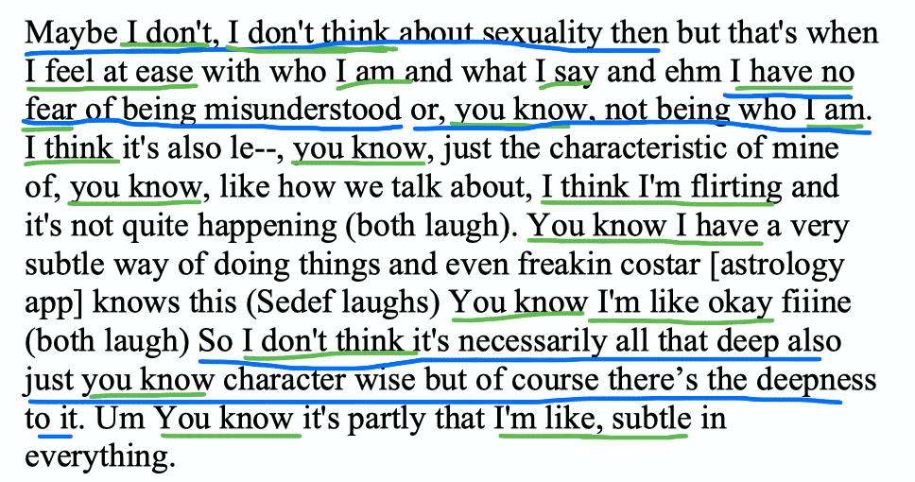
Analysis
Voice of the Self
Voice of Cognition
Notes:
Excerpt when I ask her to elaborate more on what sexual empowerment looks like for her. She says she feels sexual empowerment when there is no fear of being misunderstood, when she feels at ease and then she also justifies her subtlety in sexuality through the subtleness of her personality. And says my sexuality is ‘subtle’.
Voice of the Self. Follow & underline the ”I”s and notice when it turns to ”you”.
Voice of cognition moves in tandem with voice of the self- she identifies herself through her thinking self- cognition dominates the self
We see categorizations, meta cognition in the given example
Justifying the ‘subtleness’ of her sexuality through her personality

Slide 6
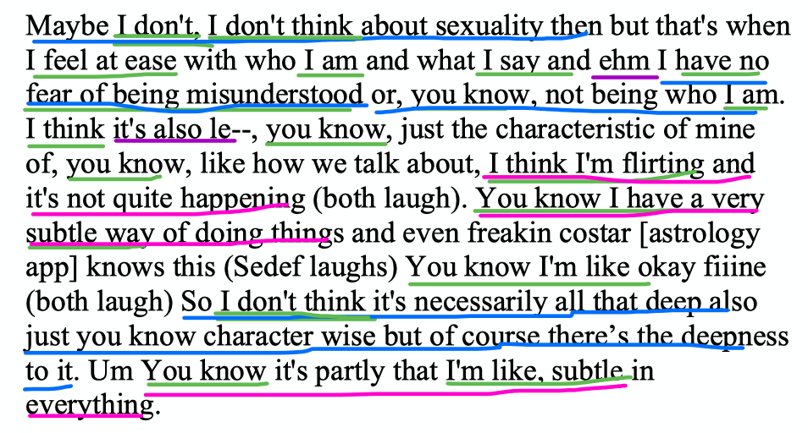
Analysis
Voice of Subtle Sexuality
Notes:
Leyla finds herself in a psychological bind: she searches for an intricate solution that will allow her to “feel empowered” without being categorized: “It’s still a question for me”; she says, “what empowering sexuality looks like for me”. She tries to find an answer in this bind against the constraints of categorizations, that creates a binary between “sexuality” and “intelligence”, and she seems to find a solution through the Voice of Subtle Sexuality. I notice her hiding her sexuality behind her intellect and creativity: “If I’m seen that way [sexual] right away then I can’t build on my intelligence or creativity”. I find evidence in the overuse of “I think”s in her I-poem, and the way Leyla talks about sexuality through the analytic lexicon, without almost any references to desire and feelings. It seems that Leyla’s sexuality may be hiding behind her intelligence, making it hard to detect it or feel it. The psychological logic evidenced is that if her own sexuality is delicate or precise as to be difficult to analyze or describe, people cannot pigeonhole her. The subtlety escapes categorizing. So, being sexually subtle may be a solution to the bind of escaping categorizing, avoiding punishment and still asserting sexual empowerment:
Psychological bind: She wants to be sexually empowered “im searching for what sexual empowerment looks like for me” but she does not want to be categorized as a slut “its not instrinsic to me to use my sexuality to get to a place of power”, “if you show your boobs you are categorized as a certain woman”– this is a gordian knot she grapples with.
She finds an intricate solution to this bind: Subtle Sexuality. She escapes being categorized as a slut by employing “subtle sexuality”; sexuality that is difficult to detect, that is only delicately visible.
If her sexuality is subtle, people cannot pigeonhole her, she escapes categories and then also can claim “authentic sexual empowerment’, this is ”my kind of sexuality”.

Slide 7
Where is the ?
Analysis
Erotic Voice
Notes:
The Erotic Voice is hardly ever there, though we see glimpses of it at times, the absence of the erotic voice shows how employing subtle sexuality is a non-solution solution. This “solution” enables her to “be” empowered and enables her to shift away from potential embodied vulnerability and desire into safe disembodiment (she does say ‘I like to come from a place of power, not vulnerability’ at some point in the interview).
These solutions do not seem to allow room for vulnerability, desire or play; thus the obfuscation of liberation.

Slide 8
Sexual Empowerment gets in the way of Liberation
Interpretation
Notes:
Liberation refers to freedom from internal and external restrictions. It encompasses freedom that have psychic, social and political layers in which an individual experiences internalized and embodied states of freedom, while in solidarity with others in achieving the political goal of releasing others from restrictions as well (Greene, 1988). Liberation requires those embodied feelings that the hegemonic discourse keeps out, as well as a connection and solidarity with others, challenging the competition that the contours of slut shaming and heteronormativity create. “Empowerment” in this context is a fraught process, something an individual “does” that seems disembodied, analytical and strategic. The neoliberal, hegemonic empowerment discourse interferes with this process, instead of helping it.

Slide 9
Implications
Intersectionality in the Listening Guide analysis
Necessary step in finding liberatory pathways
Transnational solidarity
Notes:
Intersectionality & transnationality in the Listening Guide analysis
how can race/class/immigration/place inform/deepen our interpretations in LG analyses? Sexuality discourses in Turkey (danger); immigration (Espin)- empowerment discourse and risk discourse how immigrant women struggle with contradictory discourses
Transnational solidarity
asking these questions in other places; forming “glocal” solidarities
Raising important questions that pave the way towards social change
what will it take for Leyla to “find” a solution, to feel embodied power, vulnerability and desire, in pursuit of liberation?
Uncovering these psychological logics that constitute coc-solution solutions makes systemic binds visible, which is a Necessary step in finding liberatory pathways
Diving deep into Leyla’s psychological logic through the LG method reveals how the "do it yourself" discourse pushes heterosexual women into non-solution solutions that allow them some room to come up for air, yet not enough room for play, desire, and freedom. The lexicon of sexual empowerment interacts with what women know from their experience, and the LG method allows us to uncover the psychological logic that holds ways of how women psychologically solve this problem. Through tracing voices in Leyla’s psyche, I uncovered one way of solving the psychological bind, which is through subtle sexuality. Subtle sexuality seems like good a solution but requires a sacrifice of the self that is undermining of liberation and keeps the systems such as slut shaming and heteronormativity in place. The expense of the solution was made visible through the LG method embedded in qualitative feminist theory (Brown & Gilligan, 1992). Uncovering these psychological logics that constitute non-solution solutions makes these systemic binds visible, which is a necessary step in finding liberatory pathways.

Slide 10
References
Bay-Cheng, L. Y. (2012). Recovering empowerment: De-personalizing and re-politicizing adolescent female sexuality. Sex Roles, 66(11), 713-717.
Brown, L. M., & Gilligan, C. (1991). Listening for voice in narratives of relationship. New directions for child and adolescent development, 1991(54), 43-62.
Crenshaw, K. (1989). Demarginalizing the intersection of race and sex: A black feminist critique of antidiscrimination doctrine, feminist theory and antiracist politics. u. Chi. Legal f., 139.
Fahs, B., Swank, E., & McClelland, S. I. (2018). Sexuality, pleasure, power, and danger: Points of tension, contradiction, and conflict.
Pease, B. (2002). Rethinking empowerment: A postmodern reappraisal for emancipatory practice. The British Journal of Social Work, 32(2), 135-147.
Riger, S. (2002). What’s wrong with empowerment. In A quarter century of community psychology (pp. 395-408). Springer, Boston, MA.
Gutierrez, L. M. (1995). Understanding the empowerment process: Does consciousness make a difference?. Social work research, 19(4), 229-237.
Rutherford, A. (2018). Feminism, psychology, and the gendering of neoliberal subjectivity: From critique to disruption. Theory & Psychology, 28(5), 619-644.
Sandra Silverman L.C.S.W. (2015) The Colonized Mind: Gender, Trauma, and Mentalization, Psychoanalytic Dialogues: The International Journal of Relational Perspectives, 25:1, 51-66, DOI: 10.1080/10481885.2015.991246
Segalo, P., & Fine, M. (2020). Under lying conditions of gender‐based violence—Decolonial feminism meets epistemic ignorance: Critical transnational conversations. Social and Personality Psychology Compass, 14(10), 1-10.
Tolman, D. L. (2012). Female adolescents, sexual empowerment and desire: A missing discourse of gender inequity. Sex Roles, 66(11), 746-757.
Tolman, D. L., & Head, J. C. (2021). Opening the Black Box: A primer for the Listening Guide method of narrative inquiry. Qualitative Psychology, 8(2), 152.
Vance, C. S. (1984). Pleasure and danger: Toward a politics of sexuality. Pleasure and danger: Exploring female sexuality, 1(3).

